Slide 1
Exam Preparation Session

Slide 2
Disclaimer
All hints and information rely on personal knowledge and experience.
The administration of the TUM School of Management is the only source for legally binding information.

Slide 3
3 out of 4 hurdle - Basic modules
Basic modules, where the 3 out of 4 rule applies
Mathematics I
Management Science
Economics I (VWL I)
Statistics (starts in 2nd semester)
At least 3 out of the 4 exams must be passed or you will be exmatriculated!
Only 1 retake is possible for each of these exams.

Slide 4
Credits per semester
No specific credit requirements for the 1st and 2nd semester
Pass 3/4 basic modules
At the end of the 3rd semester you will need to have at least 30 credits
With each semester, the minimum credits requirement increases by 30 credits
If you don’t reach the minimum amount of credits => Exmatriculation!

Slide 5
Mathematics I
Basic Module
Date & Time: 14.02.2022, 8:00-9:30AM
Type: Open questions
Retake: 14.04.2022, 14:15-15:45PM
Format: On site
Tips:
Solve all the exercise sheets (even more than once)
Old exams (structure may vary)

Slide 6
Economics I (VWL I)
Basic Module
Date & Time: 21.02.2022, 8:00-10:00
Type: MC Questions (only ONE of the four given options is correct)
Retake: Summer Semester 2022
Format: online
Maximum score: 40 questions, 3 points each → 120 points in total
Tips:
Exercises from the exercise sheets
Exam quizzes
Previous exams

Slide 7
Management Science
Basic Module
Date & Time: 28.02.22, 17:00 – 18:00
Type: Open questions
Retake: Summer Semester 2022
Format: On-site
Maximum score: 60 points
Tips:
Solve exercises from the script
Previous exams
During the exam: if you don’t know how to solve an exercise, jump to the next one

Slide 8
Entrepreneurship & Business Ethics
Date & Time: 18.02.2022, 14:15-16:15
Type: MC Questions (only ONE of the four given options is correct)
Retake: Summer Semester 2022
Maximum score: 100 points (50 pts. Entrepreneurship + 50 pts. BE)
Format: On-site
Tips:
Read through all slides (Questions can include all topics from the lecture)
Guest lectures
For Business Ethics: read “Einführung in die Wirtschaftsethik” von Prof. Lütge
A lot of stuff to learn by heart!

Slide 9
Financial Accounting (Buchführung)
Date & Time: 04.04.2022, 17:00-18:00
Type: MC Questions (only ONE of the four given options is correct)
Retake: Summer Semester 2022
80-90 questions (50% Financial Accounting + 50 % Bookkeeping)
Format: Online
Tips:
Practice with the provided MCQs

Slide 10
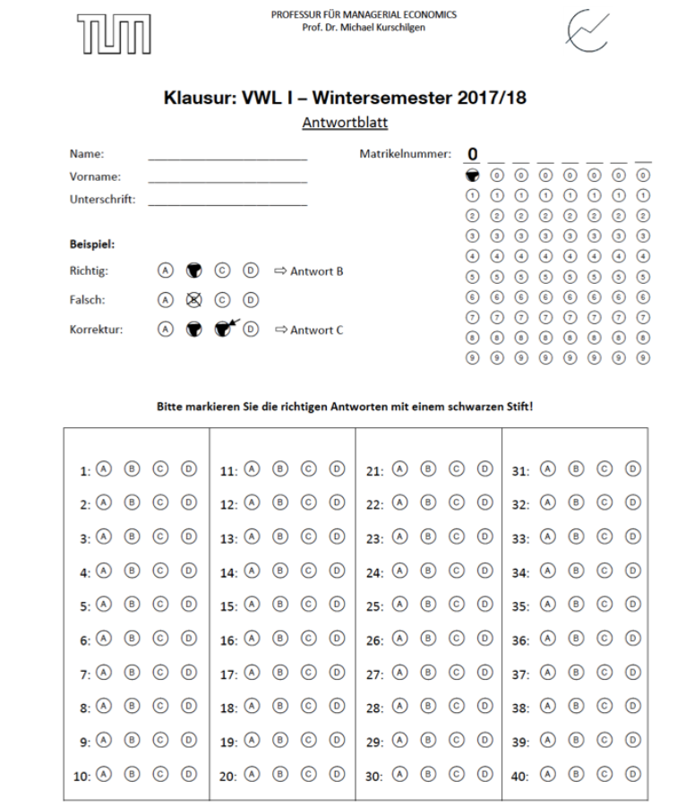
The answer sheet
Exercise sheet vs. answer sheet
Take enough time to write your answers on the answer sheet!
Open questions: short, precise answers
MCQs: Mark the correct answer by filling the circle with the corresponding letter on the answer sheet
You will be notified if other rules apply

Slide 11
Exam day
Check your exam room (TUMonline, Moodle)
BE THERE ON TIME!
The supervisors will give you all the important information you need about the exam before it begins (allowed materials, time etc.)
Don’t forget to bring you calculator (only for Economics I, Management Science)
First things first: fill in the first sheet of the exam with the information required (name, matriculation no., etc.)
You might need to write the matriculation number on every page of the exam
You can get a stamp with your name/matriculation no.
You cannot exit the room during the last 15 minutes of the exam
Don’t cheat!

Slide 12
Results
You will receive your results between 1 week and 2 months after the exam
Pass: 4.0 or higher
If you passed the exam you cannot retake it
Retake period in Summer Semester 2022
= normal exam period of the Summer Semester 2022
Exceptions:
Maths retake – April
Statistics retake – October

Slide 13
Exam review
Registration is usually through Moodle, please check your email
Begins around the time you are given your results
Written authorization + copy of your ID => your friend checking your exam if you can’t
Even MC questions may sometimes be incorrectly graded, so check carefully!

Slide 14
Websites and learning tips
Studydrive (for summaries, old exams, flash cards)
https://www.studydrive.net/
Pomodoro technique, active recalling
Study groups via Zoom or in-person
Virtual Study Room TUM “Study with me”
For more information : https://www.tum.de/studium/im-studium/erfolgreich-lernen/study-with-me/

Slide 15
Learning places
StudiTUM
University Library
Stadtbibliothek
Study rooms of TUM SOM

Slide 16
GOOD LUCK!
Questions?

